Slide 1
An Introduction to Linear Mixed Effects Models for Psychological Science
Dr. Lotte Meteyard (Dr Rob Davies) Meteyard & Davies (in prep) Best practice for linear mixed effect models in psychological science

Slide 2
Mixed models
Analysis technique that includes both fixed and random effects.
NB: they are not new
Related terms.. Linear/generalised mixed models Multilevel models/analysis Heirarchical models

Slide 3
Mixed models
Number of Pubmed citations for ‘Linear Mixed Models’ by year

Slide 4
LMM Angst
Reported challenge | %
Lack of standardized procedures | 26
Selecting and specifying models | 25
Researcher reports lack of knowledge | 18
Understanding and interpreting random effects | 14
Lack of training/guidelines for analysis, interpretation and reporting | 13
Use of new and unfamiliar software | 12
Reported challenge | %
General concern over use of LMM for own analysis | 75
Reporting results | 15
Model selection | 14
Learning and understanding analysis | 14
Lack of established standards | 11
General concern over use of LMMs for discipline | 73
Lack of standards | 23
LMMs used when not fully understood | 23
Misuse of models | 17
Reporting is inconsistent and lacks detail | 17
Peer review of LMMs is not robust | 10

Slide 5
What is a LMM?
Used for any data where there is a hierarchical or multi-level structure. That is, groups & sub-groups.
All particiapnts
Males
Stimuli set 1
Stimuli set 2
Females
Stimuli set 1
Stimuli set 2
All particiapnts
Time 1
Stimuli set 1
Stimuli set 2
Time 2
Stimuli set 3
Stimuli set 4

Slide 6
Multilevel/Hierarchical structures
Pre and post tests
Multiple stimuli, multiple grouped samples
Repeated testing
For example - data collected from the same people at different times (correlated) - data collected from the same place/location (correlated) - data collected with different groups of items/stimuli (confound of different items)

Slide 7
Multilevel/Hierarchical structures
Particularly relevant for experiments / studies in which items are confounded with conditions e.g. faces vs houses, nouns vs verbs…
Issue in these studies of the ‘Items as a fixed effect fallacy” (Clark, 1973).

Slide 8
Multilevel/Hierarchical structures
Hierarchical structures are a problem because (1) Most analyses assume data is independent – standard errors smaller if data assumed to be independent when it isn’t (2) Averaging or aggregating across groups/sub-groups can ‘hide’ the true pattern in the data - we assume taking the average is OK, but this is usually a convenient oversimplification

Slide 9
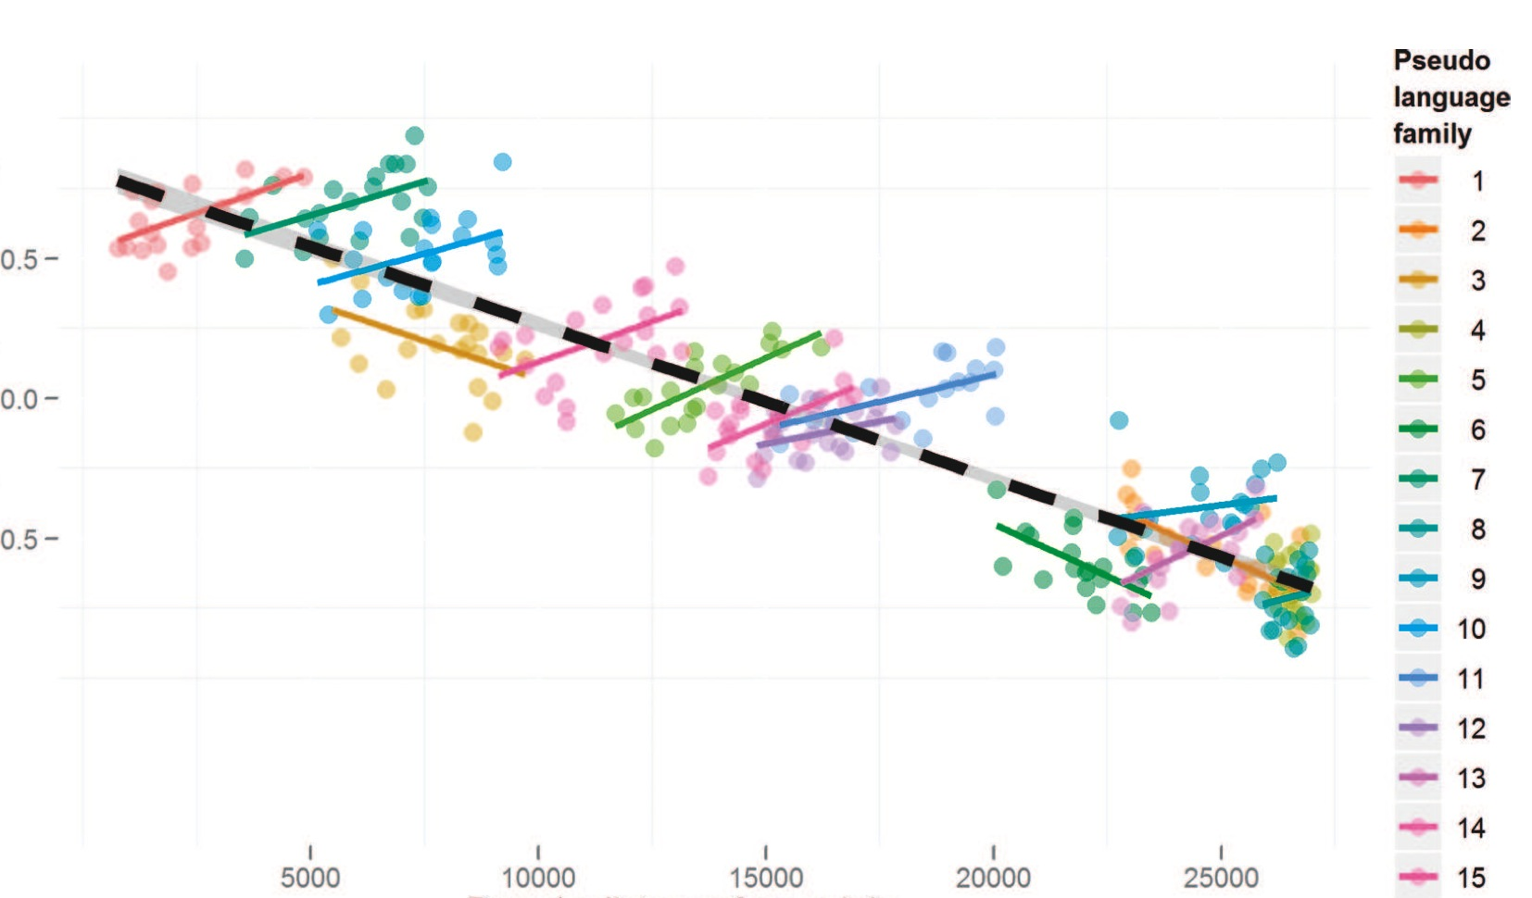
Jaeger et al (2011)
Jaeger, T. F., Graff, P., Croft, W., & Pontillo, D. (2011). Mixed effect models for genetic and areal dependencies in linguistic typology. Linguistic Typology, 15(2), 281-320.

Slide 10
When to use LMMs
Whenever you want to manage these problems… (1) Model subject & item variance (e.g. F1 vs F2) - may replace your usual ANOVA analysis (2) Model groupings in your data (e.g. over time, hierarchical designs) (3) Individual differences and effects within specific groups

Slide 11
What should my data look like?
LMMs should be seen as a form of REGRESSION So.. (1) Lots of data points to power the analysis (2) Good/sufficient variance in your data (2) Data meets assumptions of regression NB: linear mixed effects models
If you are planning on using LMMs, then design your experiment to fit LMM analysis.

Slide 12
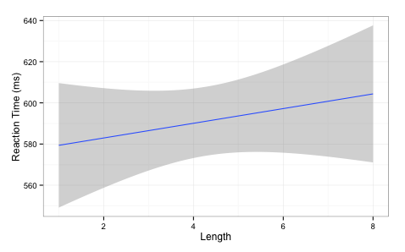
What do LMMs do?
Standard regression
slope of line
intercept
RT ~ intercept + slope(Length)

Slide 13
Regression
Experiment with RT by Length of Word (IV)
RT ~ intercept + slope(Length)
y ~ a + b(x)

Slide 14
LMM & regression
For LMMs we can model how the intercept and slope will vary across different groups
Because we are modeling variation these are called random effects (i.e. the group has some random variation associated with it). Measured in standard deviations Fixed effects are your normal predictors/IVs. Fixed because we want to know on average what they do. Measured in means.

Slide 15
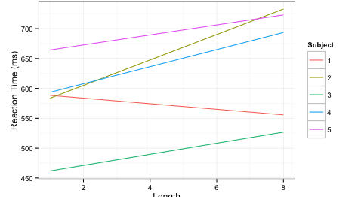
What do LMMs do?
slope is allowed to vary across groups e.g. subjects
intercepts are allowed to vary

Slide 16
What do LMMs do
For LMMs we can model how the intercept and slope will vary across different groups
For example, model the difference (i.e. the variance/deviation) for each subject from the average slope and the average intercept for all subjects. Similarly, model the difference for each item from the average slope and the average intercept for all items.

Slide 17
What do LMMs do?
That is basically it!
Gets complicated because you can end up with very large random effect structures e.g. intercepts +/- slopes for subjects, items, and more slopes varying for different predictors for different groupings slopes of interactions between fixed effects across different groups

Slide 18
Intercepts and slopes
Experiment with Subjects, Items and Length of Word (IV)
Random intercepts only
RT ~ Length + (1|Subjects) + (1|Items)
Random intercepts and slopes (nb: 1 = correlated)
RT ~ Length + (1 + Length|Subjects) + (1 + Length|Items)
Intercept varies by Subjects
Intercept varies by Items
Length varies by Subject (correlated)

Slide 19
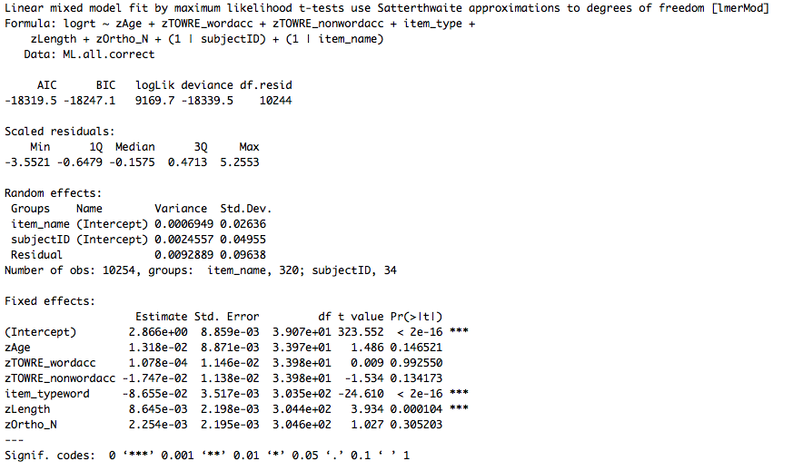
Random effects - varaince/SD associated with subject/item etc.
(e.g. difference between each subject and mean)
Fixed effects
Typically same coefficients estimates as OLS regression
Standard errors will be different

Slide 20
LMMs in R
Models estimate values for fixed and random effects NB: you are modeling your data i.e. fitted values estimated from the data
Order of entry doesn’t matter (simultaneous)
Tries to find the solution that makes the observed data most likely (maximum likelihood) ML – assumes fixed effects are precise REML – averages fixed effects and then calculates random effects
Sometimes this modeling fails (convergence)

Slide 21
Convergence
This is not just a problem with the ‘mathematical engine’
“determine whether the problem lies in a failure of the…optimization stage, as opposed to a case of model misspecification or unidentifiability or a problem with the underlying PLS algorithm. To date we have only observerd PLS failures..” Bates et al (page 24; http://cran.r-project.org/web/packages/lme4/vignettes/lmer.pdf)
Optimiziation
Model misspecification
Variance or covariance in random effects (0/1)
Unidentifiability / PLS failures
Cf: Bates et al (2015) – parsimonious models (arXiv)

Slide 22
Model building

Slide 23
There is no recipe book
Each statistical analysis has “boundary conditions” (Baayen)
Identify boundary conditions and check them
Mixed models:
Variance / number data points
(2) Normality / distribution of data (e.g. residuals, outliers)
(3) Rationale & selection of random & fixed effects
(4) ‘Final’ model – Does it look sensible? Can you interpret it?

Slide 24
There is no recipe book
Model checking and model selection
Say what model checking was done (e.g. residuals, optimization, re)
Say what approach and why (e.g. maximal to minimal; control/null model up; inclusion or not of higher order interactions)
Report model selection / testing / comparison process

Slide 25
A mixed-model workflow
Collect data
Model data
Large sample of items / trials
Check parameters / boundary conditions – outliers, scaling etc.
Maximise variance
Iterate
REPORT iterations
Most issues can be addressed by transparency..

Slide 26
Power for LMMs
Non-trivial to compute
E.g. random effect variances are essential for computing a-prior power (Westfall, Kenny & Judd, 2014)
Just adding more items OR more participants doesn’t work
Need as many sampling units as possible, since this is the main limitation on power (Snijders, 2005).
Some ‘rules of thumb’ appearing: 40 x 40 (Brysbaert & Stevens, 2018), or no less than 30-50 per sampling group (Bell et al, 2010; Maas & Hox, 2005; 2006)

Slide 27
Power for LMMs
Remember it is regression with some bells and whistles..

Slide 28
Building models: many methods
Simple model upwards: intercept only + random effects + fixed effects
Models with control variables + fixed effects
Models with main effects + interactions
Simple regression/ordinary least squares models for sub-groups/per subject/per item, to inform LMM (Gelman & Hill, 2006)
intercept = overall mean intercept assumed in lmer/R

Slide 29
Building models
Add in fixed effect predictors: should see random effect variance reduce if the predictors are doing any work
Compare successive models – does adding in a predictor make the model better?
Change either RE or FE for comparisons
Model comparison with AIC or LRT
Likelihood – of data given the model
Information criterion – trade off between likelihood of data and number of parameters
Notes:
Anderson & Burnham (early 200os) information criteria paper. (ecologists?)
Information theoretic criteria = distance between a model and observed outcomes will loose information. The real world to the simplification in your model - you have to drop complexity and loose information to make that leap.
Information Criteria are based around estimates of information lost in this move... Model selection aims to minimise information lost - the more negative the better.. Trade off between likelihood of data and number of parameters. Trade off between simplicity and complexity. Best OLS model will have minimum residuals and maximum R squared.
CF: Rob Davies stats slides (random effect structures revised pdf).
LRT = 2log likelihood-complex/likelihood-simple Usually LRT, AIC, BIC tend to move in same direction consistently – but AIC and BIC can diverge, especially with complex models – BIC can say ‘this added complexity does not add’ whereas AIC says it does Pinheiro & Bates (2000) says LRT is anti-conservative for comparing fixed effects, but OK for random effects. All parts of this computation are worked out well and model comparisons are well motivated. The LRT statistics give a distribution that is approximately X2 distributed.
For example: Kliegl, R., Hohenstein, S., Yan, M., & McDonald, S. A. (2013). How preview space/time translates into preview cost/benefit for fixation durations during reading. QJEP.
“Comparisons between models with different fixed effects are based on maximum likelihood (ML) statistics; comparisons between models with different random effects are based on restricted maximum likelihood statistics (REML); comparisons involve only strictly nested models (Pinheiro & Bates, 2000)”

Slide 30
Building models
Once have a reliable model, see if you can ‘break’ the effects you have e.g. change logRT to reciprocal (1/RT)? higher order interactions that modulate effects? other variables you expect to matter?
Consider reporting multiple models

Slide 31
Random effects
Sampling groups: subjects, items, school, etc.
You expect or predict some variation e.g. interaction of subject ability with item
LMM will tell you how much variance associated with a grouping - if very small, consider removing it. - include random effect because it is part of experiment design - include random effect because it is something you are interested in - can test models with and without (Baayen et al 2008) LRTs comparing models with same FE, differing in RE.

Slide 32
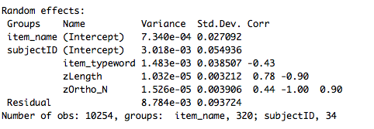
Model checks
Variance in intercepts and slopes can covary – e.g. as people get slower, effects get bigger…
Correlations between random effects are high (~0/1) - model cannot solve the variance problem - is looking for nothing

Slide 33
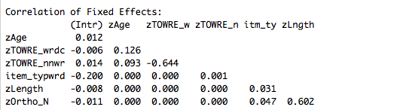
Correlation between different predictors (check for collinearity)
Mean centering & scaling (i.e. z scores of data) helps to reduce this problem

Slide 34
Reporting models
Report model comparisons and Likelihood Ratio Tests (LRT) / AIC / BIC for different models
Explain the model selection choice, based on aims of study and information criteria comparisons
Summary of fixed effects: like linear models, with CIs
Summary of random effects: variance and covariance (if applicable)

Slide 35
Reporting models
Get over reporting ‘one’ analysis of your data
A number of highly sensible papers now give a similar message – when multiple analyses (and models) are possible, best practice is to report them all and use them as a test of the robustness of effects (Carp, 2012; Steegen et al, 2016; Patel, Burford & Ioannidis, 2015).

Slide 36
p values

Slide 37
Significance and fitting
Calculation of p values is non-trivial, identifying degrees of freedom
Risk of false positive with some methods of significance estimation
Least worst option is Satterthwaite and Kenward-Rogers approximations for dfs for models estimated with REML (Luke, 2016)
Consider also model comparison vs coefficient significance

Slide 38
Hypothesis driven model selection

Slide 39
Building and choosing models
“There is no such thing as an all purpose statistical method” Nagin & Odgers, 2010, pg 132
Give rationale for the analysis & model choice
Be explicit about technical choices (e.g. random and fixed effects structures, model selection process, model checking)
Make programming script available
Report your basic data that are going into the model (e.g. central tendency, variance, distribution for the DV/response variable)

Slide 40
Building models
Too many parameters = false positives
Complex to explain and understand
Too few…. Have you included all the important parameters? (hypotheses, motivation, previous evidence..)
Model that will replicate across samples?
What complexity do you want for your research questions?

Slide 41
Hypothesis driven approach
“formulate your hypotheses and model without reference to the data (and ideally even prior to their collection)” (Roger Mundry, 2014, MPI EVA)
The problem of model complexity: even with a few predictors, there is a potentially huge number of different models that can be fit. E.g. main effects, interactions, non-linear patterns…

Slide 42
Model building
Identify ‘test’ predictors (fixed effects) that you have hypotheses about
Identify anything you want to control for (control fixed effects)
Identify random effects – this is independent from control vs test predictors. Random effects are groupings of data you expect to cause systematic variation.
Compare more complex model against ‘null’ model (e.g. RE and control variables only).

Slide 43
Model building
Interactions – think about what interactions might mean, and why you would test for them.
Mundry (2014) advice:
Write down:
why each of the terms in the model is in there
what the different terms in the model represent (i.e. what they mean, what process they represent)
what the model and the terms in it could reveal (and not reveal)
ask yourself (and all researchers involved) if the model represents what you're aiming at

Slide 44
Recommended reading (for clarity)
Bolker, B. M., Brooks, M. E., Clark, C. J., Geange, S. W., Poulsen, J. R., Stevens, M. H. H., & White, J. S. S. (2009). Generalized linear mixed models: a practical guide for ecology and evolution. Trends in Ecology & Evolution, 24, 127-135.
Jaeger, T. F., Graff, P., Croft, W., & Pontillo, D. (2011). Mixed effect models for genetic and areal dependencies in linguistic typology. Linguistic Typology, 15(2), 281-320.
Gelman, A., & Hill, J. (2006). Data analysis using regression and multilevel/hierarchical models. Cambridge University Press.

Slide 45
Recommended reading (for clarity)
Papers by Reinhold Kliegl (Potsdam)
Dan Mirman’s R resources page (Alabama, Birmingham) http://www.danmirman.org/r-resources

Slide 46
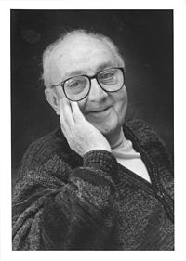
Thank you for listening
“Essentially, all models are wrong, but some are useful” George E.P. Box
Box, G. E. P. & Draper, N.R. (1987). Empirical Model-Building and Response Surfaces, p. 424, Wiley

